Slide 1
CSS - Training

Slide 2
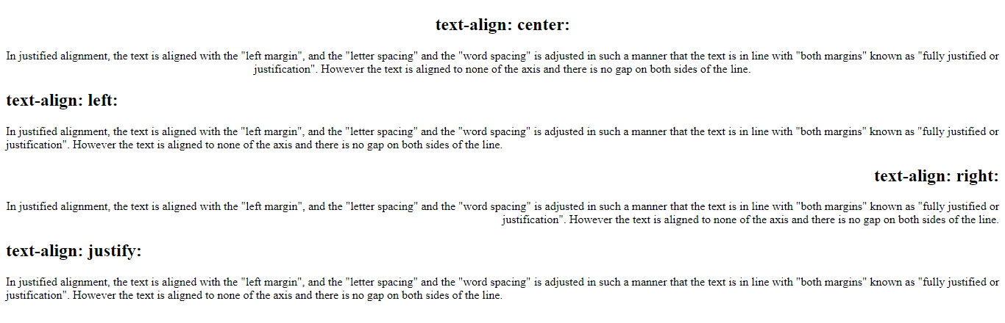
Text-align

Slide 3
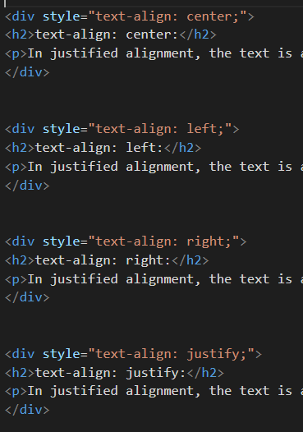

Text-align

Slide 4
CSS Properties
Colors - Colors are specified using predefined color names, or RGB, HEX, HSL, RGBA, HSLA values.
Text Color
Border Color
Background Color
Color Values - In CSS, colors can also be specified using RGB values, HEX values, HSL values:
<h1 style="color:blue;">Hello World</h1>
<h1 style="border:2px solid Tomato;">Hello World</h1>
<h1 style="background-color:DodgerBlue;">Hello World</h1>
Tomato
rgb(255, 99, 71)
background-color:rgba(255,0,0,0.3);
#ff6347
hsl(9, 100%, 64%)

Slide 5
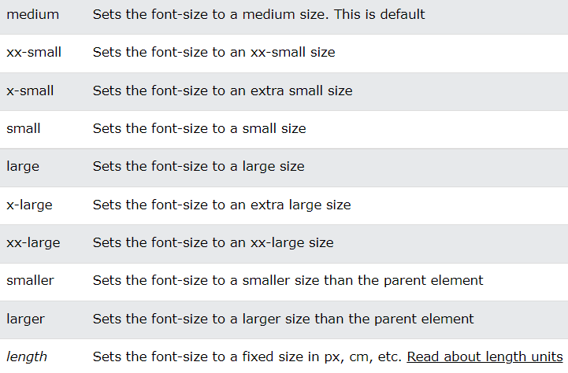
Font-size

Slide 6
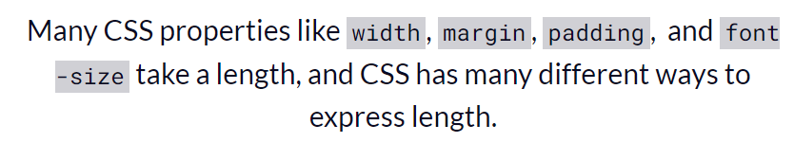
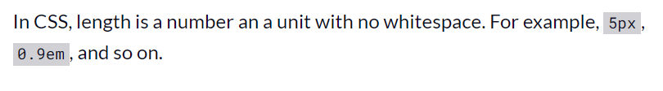
CSS Unit

Slide 7
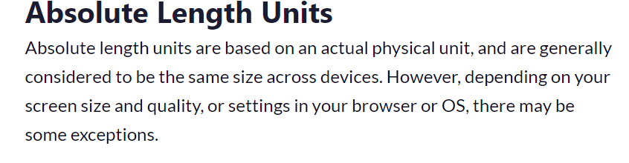
There are two general kinds of units used for length and size in CSS: absolute and relative.

Slide 8
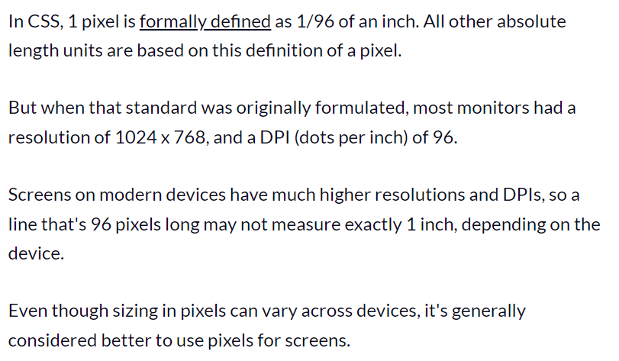
Absolute Length Units

Slide 9
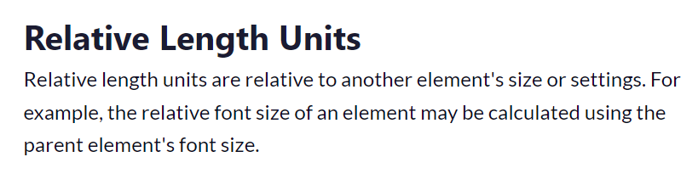
Relative Length Units

Slide 10
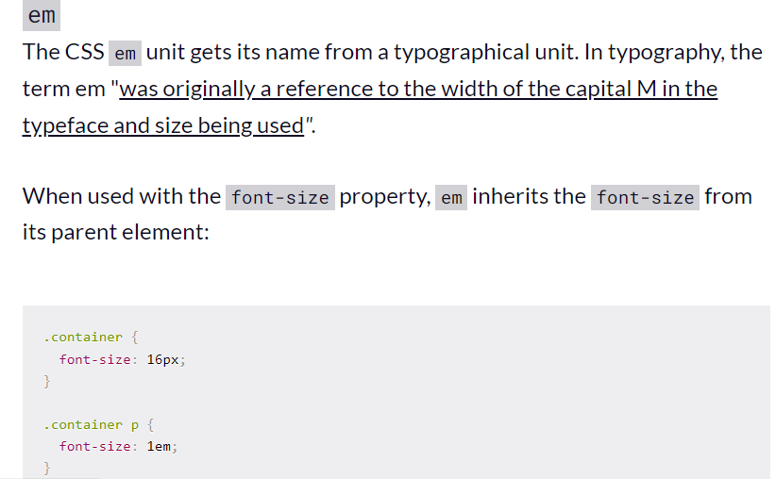
Relative Length Units

Slide 11
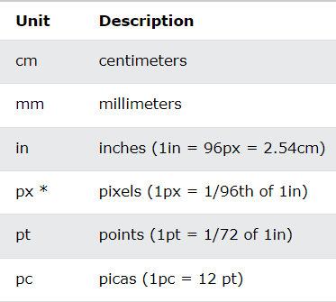
Other example of absolute Units

Slide 12


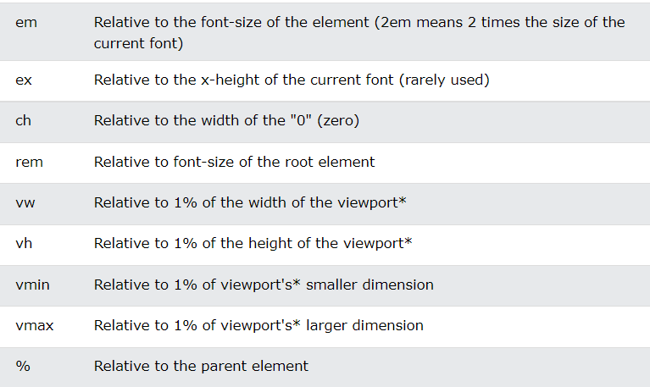
Other example of relative Units

Slide 13
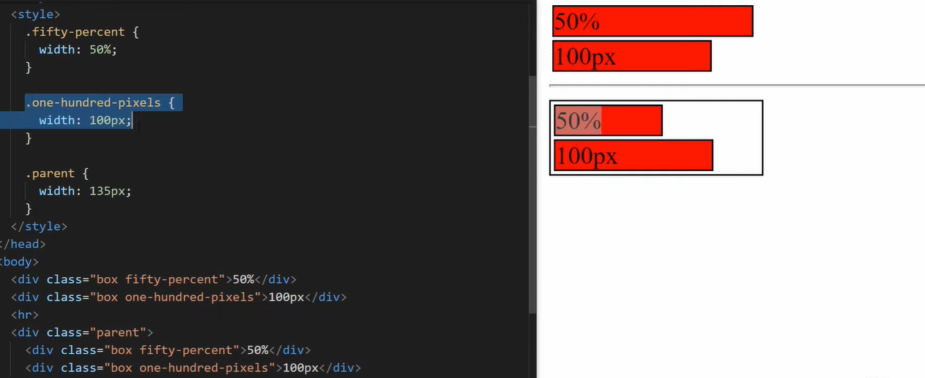
Other example of relative and absolute % related to parent

Slide 14
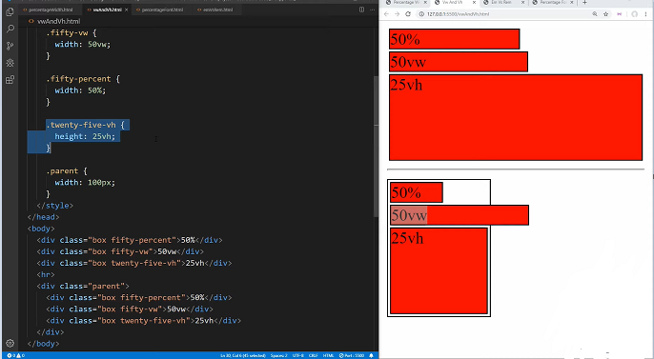
Other example of relative and absolute vw and vh related to screen size

Slide 15
CSS Basic Selectors
A CSS selector selects the HTML element(s) which we want to style
Types of Selectors:
CSS element Selector
CSS id Selector
CSS class Selector
CSS Universal Selector
CSS Grouping Selector

Slide 16
CSS Selectors
CSS element Selector: - The element selector selects HTML elements based on the element name
CSS id Selector - id selector uses the id attribute of an HTML element to select a specific element
CSS class Selector - Class selector selects HTML elements with a specific class attribute
p { text-align: center;
color: red; }
#textBoxName{ text-align: center; color: red; }
.portal { text-align: center; color: black; }

Slide 17
CSS Selectors
CSS Universal Selector: - CSS rule below will affect every HTML element on the page
CSS Grouping Selector
* { text-align: center; color: blue; }
h1 { text-align: center; color: red; } h2 { text-align: center; color: red; } p { text-align: center; color: red; }
h1, h2, p { text-align: center; color: red; }

Slide 18
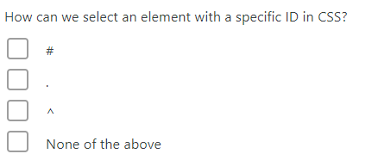
Question

Slide 19
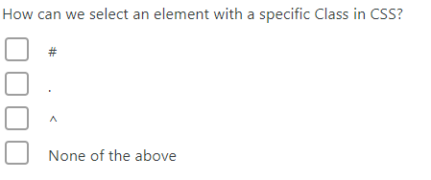
Question

Slide 20
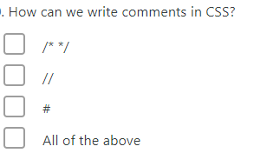
Question

Slide 21
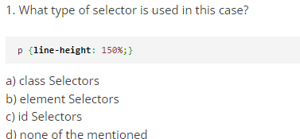
Question

Slide 22
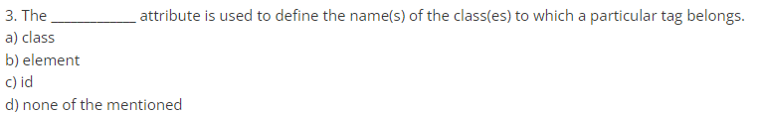
Question

Slide 23
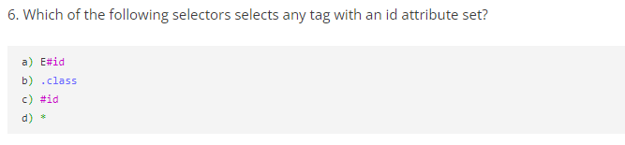
Question

Slide 24
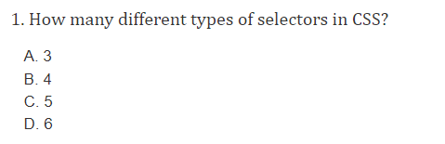
Question

Slide 25
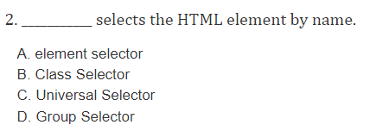
Question

Slide 26
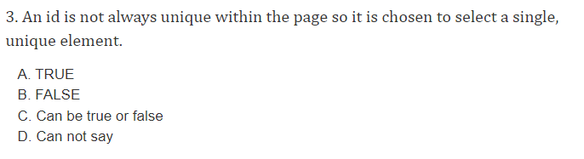
Question

Slide 27
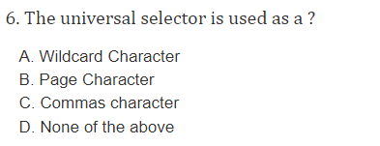
Question

